Slide 1
CS 211 Computer Architecture
Lecture 20: RISC-V – Machine Language - 1
Ravi Mittal
ravi.mittal@iitgoa.ac.in
Indian Institute of Technology, Goa

Slide 2
Acknowledgements
Class Presentation, CS61C, Introduction to Assembly Language and RISC-V Instruction Set Architecture, University of Berkeley, Prof Krste Asanović & Randy H. Katz. http://inst.eecs.Berkeley.edu/~cs61c
Book: Digital Design and Computer Architecture: RISC-V Edition, Harris & Harris Elsevier – Presentation.
Computer Organization and Design, The Hardware Software Interface, RISC-V edition, Patterson and Hennessey

Slide 3
RISC-V: So far we have studied
Arithmetic operations: add, sub, addi,
How to bring data from memory to register and vice versa?
  lw, sw, lb, sb, lbu
Bit-by-bit logical instructions
  and, or, xor
  andi, ori, xori
Logical Shift instructions
  sll, srl, sra, slli, srli, srai
Generating Constants
Branching Instructions: beq, bne, blt/bltu, bge/bgeu
Jumping instruction: j
Assembly level program for: if, if/else, while, for loops
Function Calls
  Basics
  Input arguments and Return Value
The Stack
  Basics
  How functions use a stack
  Stack use in non-leaf function calls
  Recursive Functions
Floating Point Operations

Slide 4
In today’s class we will study
Instruction Formats – Design aspects
Instruction Types
R-Format Instructions

Slide 5
Instruction Format – Design Aspects

Slide 6
Instructions as Numbers
Most data we work with is in words (32-bit chunks):
  Each register is a word
  lw and sw both access memory one word at a time
So how do we represent instructions?
  Remember: Computer only understands 1s and 0s, so assembler string “add x10,x11,x0” is meaningless to hardware
  RISC-V seeks simplicity: since data is in words, make instructions be fixed-size 32-bit words also
    Same 32-bit instructions used for RV32, RV64, RV128
Prof Krste Asanović & Randy H. Katz, Univ of California, Berkeley

Slide 7

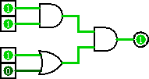
Levels of Representation/Interpretation
Higher-Level Language
Program (e.g. C)
temp = v[k];
v[k] = v[k+1];
v[k+1] = temp;
Compiler
We__
were__
here._
lw t0, 0(x2)
lw t1, 4(x2)
sw t1, 0(x2)
sw t0, 4(x2)
Assembly Language Program (e.g. RISCV)
Assembler
0000 1001 1100 0110 1010 1111 0101 1000
1010 1111 0101 1000 0000 1001 1100 0110
1100 0110 1010 1111 0101 1000 0000 1001
0101 1000 0000 1001 1100 0110 1010 1111
We__
are__
here._
Machine Language Program (RISCV)
Machine Interpretation
Hardware Architecture Description
(e.g. block diagrams)
Architecture Implementation
Logic Circuit Description
(Circuit Schematic Diagrams)
Prof Krste Asanović & Randy H. Katz, Univ of California, Berkeley

Slide 8
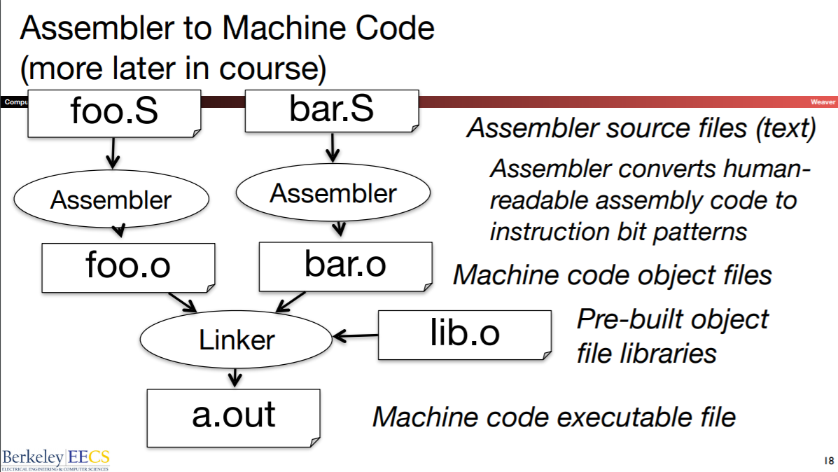
The Assembler
Prof Krste Asanović & Randy H. Katz, Univ of California, Berkeley

Slide 9
Instruction Types

Slide 10
Instructions as Numbers
By convention, RISC-V instructions are each
1 word = 4 bytes = 32 bits
31
0
Divide the 32 bits of an instruction into “fields”
  Regular field sizes → simpler hardware
  Each field tells processor something about instruction
Define 6 types of instruction formats:
  R-Format I-Format S-Format U-Format
  SB-Format UJ-Format
Notes:
6 formats to memorize, but 4 formats to internalize (R with three registers, I with two registers and an immediate, S with two registers and an address, U with a big immediate/address)

Slide 11
Instructions Types
We could define different fields for each instruction, but RISC-V seeks simplicity, so define six basic types of instruction formats:
  R-format for register-register arithmetic logical operations – Instructions using 3 register inputs
    add, xor, mul
  I-format for register-immediate arithmetic operations and loads
    addi, lw, jalr, slli
  S-format for stores - sw, sb
  B-format (also called SB - format) for branches - beq, bge
  U-format for 20-bit upper immediate instructions
    lui, auipc —upper immediate is 20-bits
  J-format (also called UJ) for jumps (minor variant of U-format)
    The jump instruction: jal
Prof Krste Asanović & Randy H. Katz, Univ of California, Berkeley

Slide 12
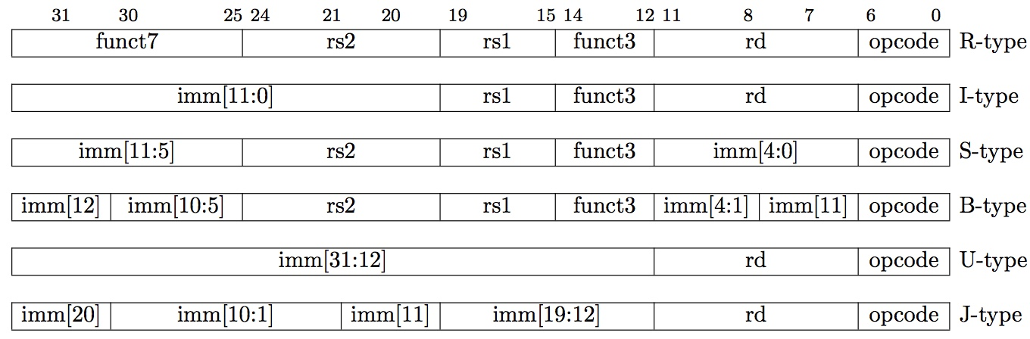
Summary of RISC-V Instruction Formats
Prof Krste Asanović & Randy H. Katz, Univ of California, Berkeley

Slide 13
R-Format Instructions

Slide 14
R-Format Instructions (1/3)
Define “fields” of the following number of bits each: 7 + 5 + 5 + 3 + 5 + 7 = 32
Each field has a name:
Each field is viewed as its own unsigned int
  5-bit fields can represent any number 0-31,
  while 7-bit fields can represent any number 0-127, etc.
31
0
7
5
5
3
5
7
31
0
funct7
rs2
rs1
funct3
rd
opcode
Ref: CS61C, Univ of California, Berkeley

Slide 15
R-Format Instructions (2/3)
31
0
funct7
rs2
rs1
funct3
rd
opcode
opcode (7): partially specifies operation
  e.g. R-types have opcode = 0b0110011, SB (branch) types have opcode = 0b1100011
funct7+funct3 (10): combined with opcode, these two fields describe what operation to perform
How many R-format instructions can we encode?
  with opcode fixed at 0b0110011, just funct varies:
  (27) x (23)= (210) = 1024
Question: Why aren’t opcode and funct7 and funct3 a single 17-bit field?
Ref: CS61C, Univ of California, Berkeley

Slide 16
R-Format Instructions register specifier
  rs1 (Source Register #1): specifies register containing first operand
  rs2 : specifies second register operand
  rd (Destination Register): specifies register which will receive result of computation
  Each register field holds a 5-bit unsigned integer (0-31) corresponding to a register number (x0-x31)
Prof Krste Asanović & Randy H. Katz, Univ of California, Berkeley

Slide 17
R-Format Example
RISCV Instruction: add x5,x6,x7
  Field representation (hexadecimal):
  Field representation (binary):
31
0
0x0
0x7
0x6
0x0
0x5
0x33
31
0
0000000
00111
00110
000
00101
0110011
_{two}
  hex representation: 0x 0073 02B3
  decimal representation: 7,537,331
  Called a Machine Language Instruction
Ref: CS61C, Univ of California, Berkeley
Notes:
x5 = t0, x6 = t1, x7 = t2

Slide 18
R-Format Example
Note the order of registers in the assembly code:
add rd, rs1, rs2
Ref: Harris and Harris Book: Digital Design and Computer Architecture: RISC-V Edition

Slide 19
More R-type Examples
Note immediate shift instructions (like srai t1, t2, 29) are R-type instructions. They encode the shift amount in the rs2 field.
Ref: Harris and Harris Book: Digital Design and Computer Architecture: RISC-V Edition

Slide 20
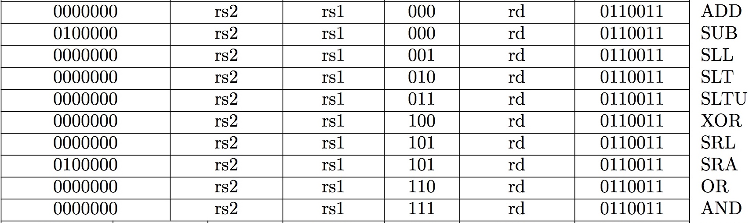
All RV32 R-format instructions
Different encoding in funct7 + funct3 selects different operations

Slide 21
Class Summary
Instructions can be designed in multiple ways based on
  Legacy constraints
  Application type
  Simple and uniform instruction format
    All instructions have fields of certain type of fixed length
RISC-V instructions are
  Simple, Regular, complete and elegant
  Uniform
  Easy to understand
  Easy to implement
We have studied machine instruction (instruction format) for R-type instructions

